Slide 1


Car Point Customer Analytics
This Presentation has analyzed vast amounts of data to uncover hidden trends, preferences in order to improve our services and ultimately drive sales growth.
Key Points of the presentation:
Customer Demography
Total Revenue
Revenue Generated Monthly
Customer’s Satisfaction
Region Performance
Company’s Make

Slide 2
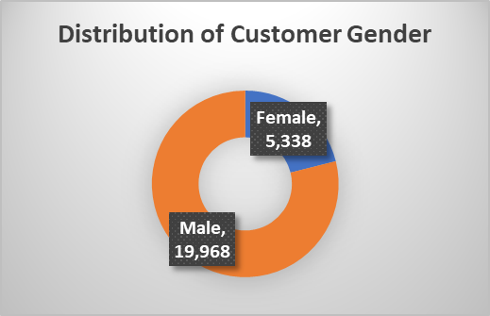
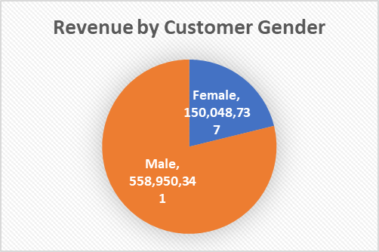
Customer Demography
Customer genders are not evenly distributed
Majority of the revenue generated are gotten from the male customers compared to the female customers.

Slide 3
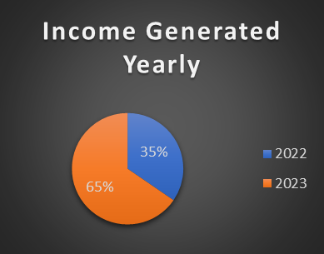
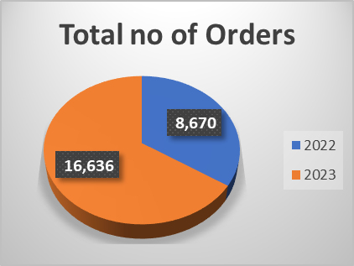
Total Revenue
Income sales for 2023 has increased compared to 2022 indicating a substantial growth
The number of orders we had for 2023 was more than the one we had for 2022.

Slide 4
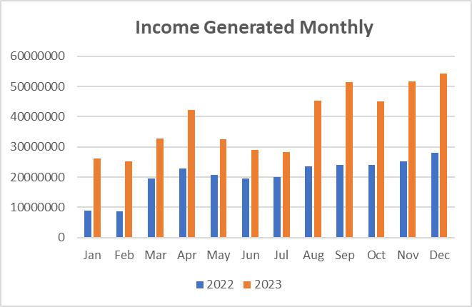
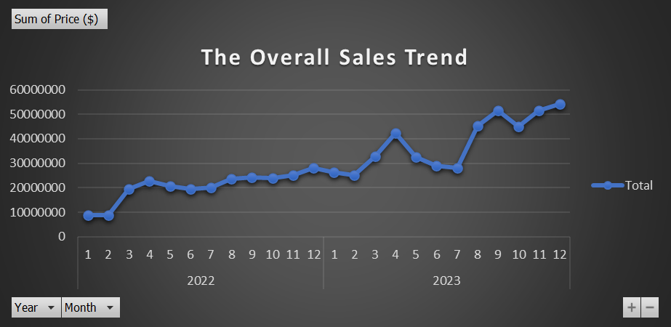
Revenue Generated Monthly
For all the Months for 2023 Sales remained elevated throughout 2023, compared to 2022.
We can see that there is a continuous increased trend in our sales.

Slide 5
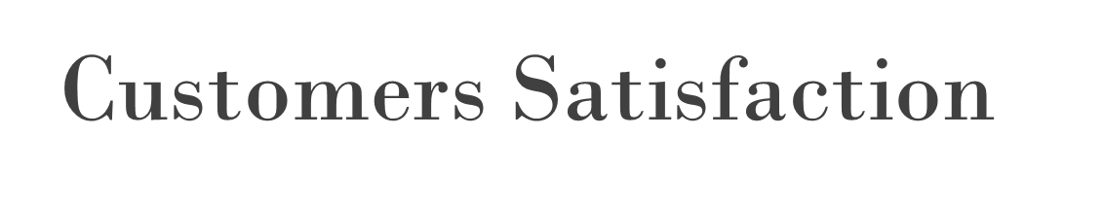
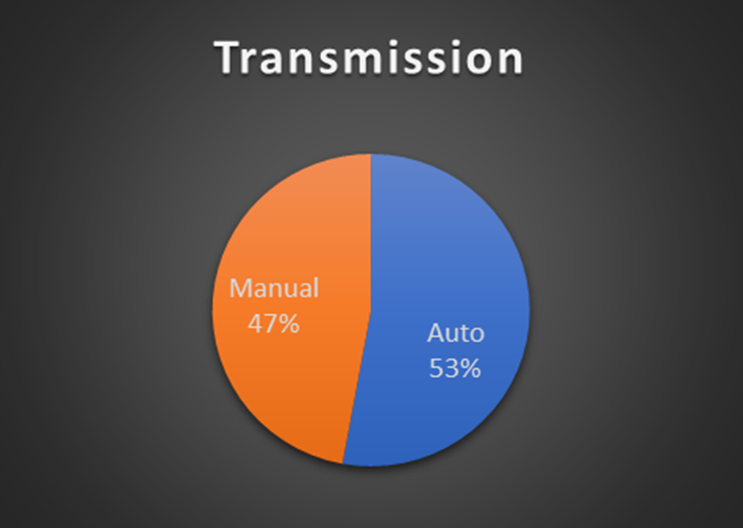
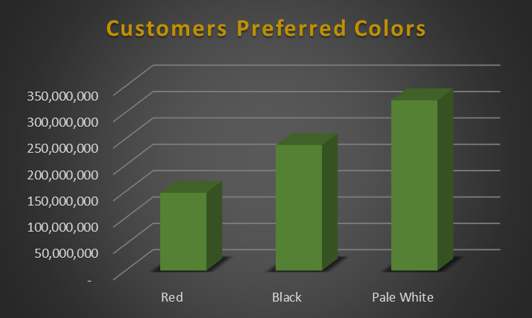
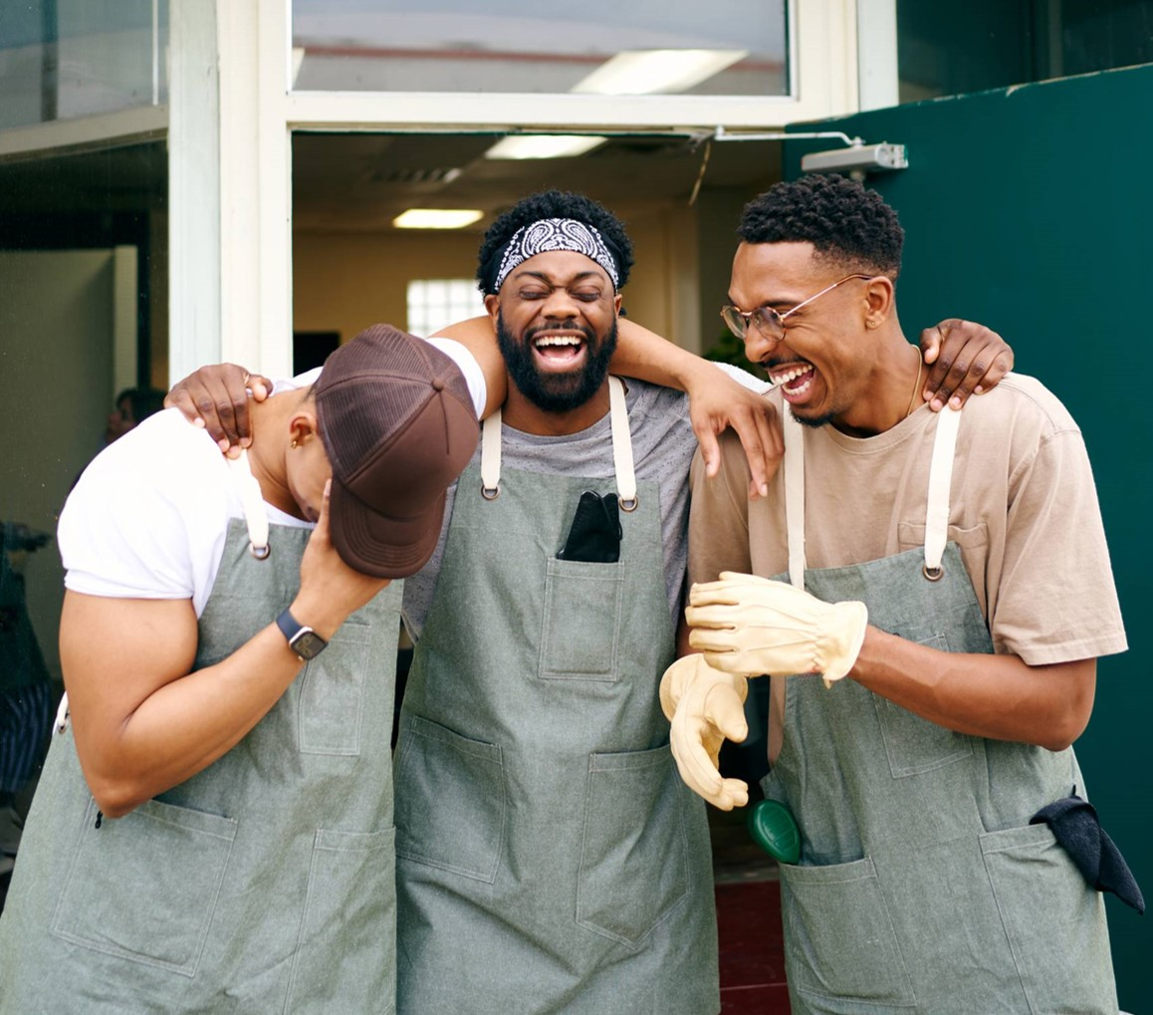
The automatic cars are of high demand The pale white color are also of high demand

Slide 6

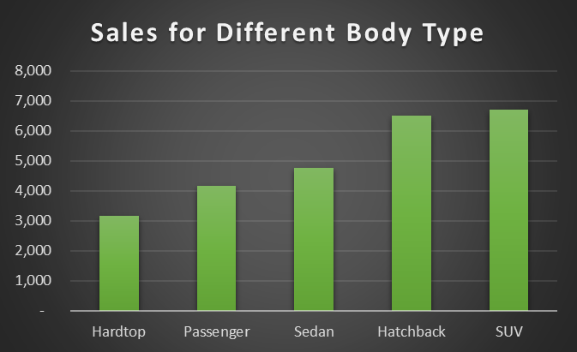
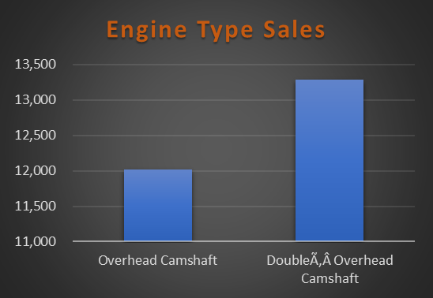

Customer Satisfaction
More of the SUV was purchased, followed by the Hatchback
Also, cars with a Double Ã‚Â Overhead Camshafts is of high demand

Slide 7
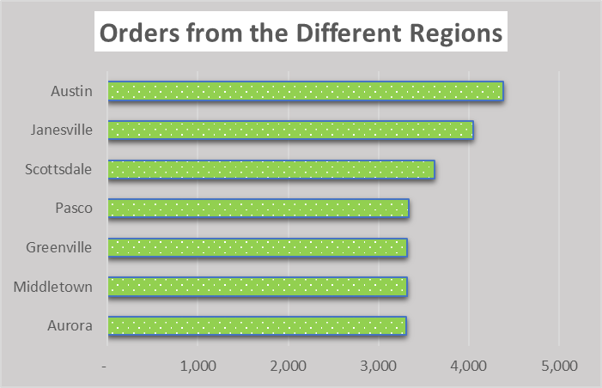
Region Performance
Market gap: few, if any, products on the market help customers like we do
Customers: 66% of US consumers spend money on multiple products that only partially resolves their issue
Financials: millennials account for about a quarter of the $48 billion spent on other products in 2018
Costs: loss of productivity costing consumers thousands of dollars
Usability: customers want something easy to use that helps make their life easier
This chart flow are for the different regions; and we can see that more of our customers are located I Austin and Janesville

Slide 8
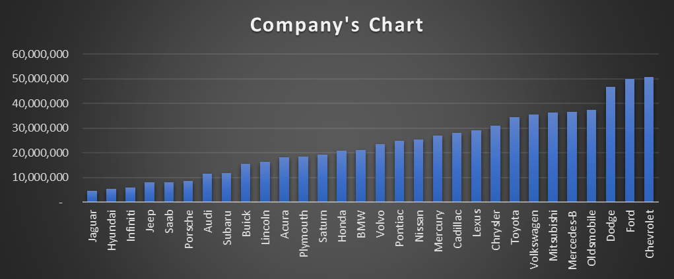

Company Make
The Chevrolet, Ford and Dodge are of high demands.

Slide 9
Conclusions
Female-focused marketing campaigns should highlight safety, practicality, and comfort features
Customer satisfaction: Services should be improved to increase customer Satisfaction.
Development of strategies to improve the level of patronage in the various regions. This may includes promos, discounts sales or even free delivery services.
Collaborating with the Different manufactures for strategies to improve sales of brands which had low demands. It can be running a promo and discount sales.

